Slide 1
Professor Corinna Hawkes
Co-Chair, Independent Expert Group of the Global Nutrition Report
2018 Global Nutrition Report
November 2018

Slide 2
About the Global Nutrition Report

Slide 3
The Global Nutrition Report 2014 to today
2018 Global Nutrition Report
Shining a light to spur action on nutrition
2017 Global Nutrition Report
Nourishing the SDGs
2016 Global Nutrition Report
From promise to impact: ending malnutrition by 2030
2015 Global Nutrition Report
Actions and accountability to advance nutrition and sustainable development
2014 Global Nutrition Report
Actions and accountability to accelerate the world’s progress on nutrition

Slide 4
The 2018 Global Nutrition Report
Chapter 1
Why malnutrition matters
Chapter 2
The burden of malnutrition
Chapter 3
Three issues in critical need of attention
Chapter 4
What people eat and why it matters
Chapter 5
The fight against malnutrition – commitments and financing
Chapter 6
Critical steps to get nutrition on track

Slide 5
What progress has there been in reducing malnutrition?

Slide 6
Stunting is declining (2000–2017)
Most significant declines are in Asia and Latin America and the Caribbean
198.4
150.8
Children affected, millions
30.1
38.3
Stunting
Overweight
Source: NCD Risk Factor Collaboration

Slide 7
New innovations in geospatial data shows it varies significantly within countries
Prevalence of stunting in Africa
2000
2005
2010
2015
Prevalence, %
<10
30
≥50

Slide 8
48% of countries are on track for at least one nutrition target
Global nutrition targets for 2025
Global non-communicable disease targets for 2025 (diet-related)
TARGET 1:
40% reduction in the number of children under 5 who are stunted
TARGET 4:
No increase in childhood overweight
TARGET 4:
30% relative reduction in mean population intake of salt
TARGET 2:
50% reduction of anaemia in women of reproductive age
TARGET 5:
Increase the rate of exclusive breastfeeding in the first 6 months to at least 50%
TARGET 6:
A 25% relative reduction in the prevalence of raised blood pressure
TARGET 3:
30% reduction in low birth weight
TARGET 6:
Reduce and maintain childhood wasting to less than 5%
TARGET 7:
Halt the rise in obesity and diabetes

Slide 9
Exclusive breastfeeding has increased 4 percentage points since 2012 to 41%
Burkina Faso
Exclusive breastfeeding rates improved from 9% to over 50% between 1992 and 2014
TARGET 5:
Increase the rate of exclusive breastfeeding in the first 6 months to at least 50%
Nepal Exclusive breastfeeding in targeted districts increased from 46% to 70% between 2012 and 2016

Slide 10
Yet progress towards targets is too slow
Maternal, infant and young child nutrition targets
Nutrition-related NCD targets
Anaemia
Obesity, men
49
138
7
180
14
Exclusive breastfeeding
Obesity, women
31
13
20
130
178
16
Childhood stunting
Diabetes, men
24
27
16
127
8
182
4
Childhood overweight
Diabetes, women
38
23
133
26
164
4
Childhood wasting
37
12
24
121
On course
Some progress
No progress or worsening
No data

Slide 11
… including for stunting
Childhood stunting
Off course
Target: 40% reduction in the number of children under 5 who are stunted
Baseline (2012)
165.2m
2017 data
There will be about 130 million stunted children in 2025 if current trends continue.
150.8m
Target (2025)
Around 100m

Slide 12
Stunting is shown to be higher in conflict versus non-conflict countries
20%
Children affected by stunting
Prevalence of stunting in conflict countries versus non-conflict countries
80%
Children not affected by stunting
34%
Children affected by stunting
66%
Children not affected by stunting
Countries affected by conflict
Countries not affected by conflict
2018 Global Nutrition Report

Slide 13
Rates of anaemia and women underweight have barely changed
Global prevalence of anemia, overweight (including obesity) and underweight in women, 2000–2016
Prevalence of overweight and obesity among adult women (18+)
39.2%
31.7%
Prevalence of anaemia among women of reproductive age (15–49)
31.6%
32.8%
Prevalence of underweight among women aged 20–49
Prevalence, %
11.6%
9.7%

Slide 14
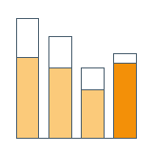
We still lack key evidence for tackling micronutrient deficiency
?
?
It’s often cited that
“Over 2 billion people worldwide suffer from a chronic deficiency of micronutrients, a condition known as hidden hunger”. (World Health Organisation, 2006)
Yet we don’t know the state of micronutrient deficiencies in nutritionally vulnerable populations, such as children under five years of age, women and adolescent girls
?
?
?
?
?
?

Slide 15
Adult overweight and obesity continue to rise
Global prevalence of obesity (BMI ≥30) among adults aged 18 years and over, 2000–2016
15.1%
10.6%
13.1%
8.7%
11.1%
Prevalence, %
Total
6.7%
Women
Men

Slide 16
Significant challenges in adolescent nutrition
Adolescent obesity, ages 10 to 19 years, by region, 2016
Poor dietary behaviour
We need ever greater focus on this critical life stage in global and national efforts on nutrition
Boys
Girls
Daily soda
Asia
Oceania
Prevalence %
Africa
Latin America and the Caribbean
2018 Global Nutrition Report

Slide 17
88% of countries face overlapping burdens
Number of countries with overlapping forms of childhood stunting, anaemia and overweight in adult women, 2017 and 2018
Anaemia only: 5 countries
Anaemia and stunting: 26 countries
Stunting only: 1 country
15.95m children stunted and wasted
Overweight and stunting: 3 countries
Overweight, anaemia and stunting: 41 countries
8.23m children stunted and overweight
Overweight and anaemia: 54 countries
141 countries in total
Overweight only: 11 countries

Slide 18
New analysis shows almost 25 million children are stunted and overweight or stunted and wasted
Children under 5 experiencing two forms of malnutrition

Slide 19
What progress has there been in improving diets?

Slide 20
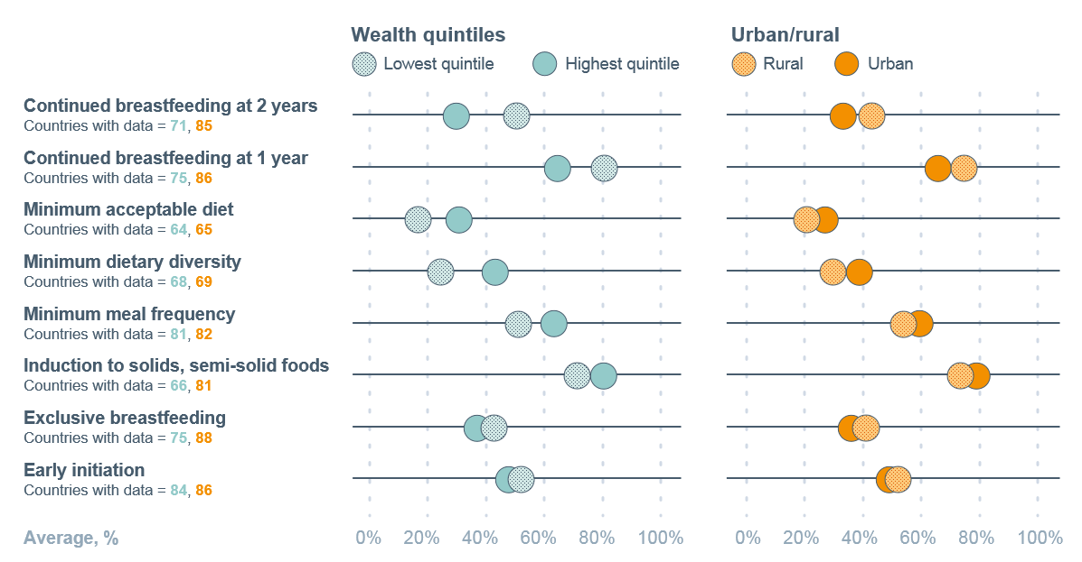
Diets of infants and young children are suboptimal everywhere
How infant and young child feeding practices differ across wealth quintiles, and urban and rural areas

Slide 21
Infant formula (0–36 months) sales increased from 16.0kg–28.5kg per infant 2005–2017
Trends and patterns in per infant/child commercial breast milk substitutes sales by region, 2005–2017
60
56.2
55.2
51.5
49.0
50.3
50
47.3
43.7
40
40.6
Standard (0–6 months)
29.2
28.5
30
Sales (kg) per infant/child
25.7
24.6
21.6
Follow-up (7–12 months)
20.7
20.3
20
17.2
15.7
16.0
Growing-up (13–36 months)
11.7
12.3
10
5.9
6.5
7.1
Special (0–6 months)
5.0
0
2005
2009
2013
2017
2005
2009
2013
2017
2005
2009
2013
2017
2005
2009
2013
2017
2005
2009
2013
2017
2005
2009
2013
2017
North America
Europe
Asia
Latin America
Africa
Global

Slide 22
Diets low in nutritious foods are a leading cause of healthy life years lost
Risk factors
DALYs related to each dietary risk factor
A diet that is low in
A diet that is high in
70
62.6
61.0
Ischemic heart disease
60
50
49.5
47.6
Other cancers
40
35.5
Diabetes mellitus
33.3
DALYs, millions
30
Ischemic stroke
20.1
20
14.2
Intracerebral hemorrhage
8.4
10
5.1
Colon and rectum cancer
3.4
3.2
2.6
1.2
0.8
0
Other
Salt
Trans fatty acids
Processed meat
Real meat
Sugar- sweetened beverages
Whole grains
Fruits
Nuts and seeds
Vegetables
Seafood omega-3 fatty acids
Fibre
Legumes
Poly- unsaturated fatty acids
Calcium
Milk

Slide 23
No income group is eating enough vegetables, whole grains or legumes, and all are drinking too much soda
Consumption of food groups and components across income groups, 2016
Midpoint of TRMEL
360g
0%/0g of
TRMEL
200% Of TMREL
Vegetables
20.5g
60g
Nuts and seeds
Legumes
435g
0.5%
Milk
Trans fat
1.25g
7%
Calcium
Saturated fat
Low income
250g
22.5g
Fruit
Red meat
Lower-middle income
125g
2g
Whole grain
Processed meat
11
g
Upper-middle income
0.25g
2g
Omega 3
Salt
4
4
6
g
High income
11%
2.5g
Polyunsaturated fat
Sugar-sweetened beverages
6
12
41
67
g

Slide 24
In some regions up to 33% of school-aged children eat no fruit daily – and up to 59% consume soda
Prevalence of daily fruit, vegetable and soda intake among school-age children and adolescents
Asia
Oceania
Africa
Latin America and the Caribbean

Slide 25
69% packaged foods aren’t aligned with healthy diets
Trends and patterns in per capita packaged food category sales by region, 2005–2017
Breakfast cereals
180
175
168
Ready meals
166
164
Sweet biscuits, snack bars and fruit snacks
160
144
147
146
145
142
145
140
133
138
Confectionary
125
121
120
120
116
Savoury snacks
100
KG per capita
Ice cream and frozen desserts
80
77
65
71
68
71
74
Edible oils
60
54
61
46
51
Sauces, dressings and condiments
40
35
40
Processed meat and seafood
20
Dried processed foods
0
2005
2009
2013
2017
2005
2009
2013
2017
2005
2009
2013
2017
2005
2009
2013
2017
2005
2009
2013
2017
2005
2009
2013
2017
2005
2009
2013
2017
Baked goods
North America
Europe
Oceania
Asia
Latin America
Africa
Global

Slide 26
But there is progress in effective policies and programmes
More countries have mandatory fortification
86 countries now require at least one type of cereal grain to be fortified with iron and/or folic acid. Only 19 countries are still classified with insufficient iodine intake, a dramatic shift from 110 countries in 1993
3. Multi-sector action in cities is growing
Decline of obesity in Amsterdam by 12.5%, declines in municipalities in the US
2. Governments are acting to improve diets
59 countries impose taxes on sugar-sweetened beverages, many in the context of excess intake: Mexico saw 9.7% decline in spending on sugary drinks within 2 years
4. Multi-level, community based interventions show rapid impact
Minimum dietary diversity prevalence increased 5.2%–24.9% in communities with intense activity by “Alive and Thrive” in Ethiopia 2015–2017

Slide 27
…. and growth in data initiatives to help us understand the role of diet in malnutrition
Global Dietary Database
Global Burden of Disease study
FAO/WHO GIFT
Gallup Diet Quality Worldwide project,
International Dietary Data Expansion (INDDEX) Project
Intake at the Center for Dietary Assessment at FHI 360
IANDA project
Fill the Nutrient Gap tool
INFORMAS
Range of initiatives for adolescents, bringing in their voices e.g. TALENT, CO-CREATE

Slide 28
What progress has there been in financing and commitments?

Slide 29
Disbursements to nutrition through overseas development assistance were US$856 million in 2016
Basic nutrition ODA disbursements, 2007–2016
1.2
0.6%
1.0
0.5%
0.8
0.4%
ODA, US$ billions
% of total ODA
Government donors
0.6
0.3%
Multilateral institutions
0.4
0.2%
% of total ODA
0.2
0.1%
0
0%
2007
2010
2013
2016

Slide 30
The N4G financing target was met 2 years early
N4G
NUTRITION FOR GROWTH PLEDGE
Target exceeded
two years early
Milan Summit 2017:
an additional US$640 million was pledged and all financial commitments were SMART.
by 2020
disbursed in 2018
US$19.6 bn
US$21.8 bn

Slide 31
Disbursements to diet-related NCD projects rose to US$32.5 million in 2016
Diet-related NCD ODA disbursements and commitments, 2014–2016
Commitments
Disbursements
Disbursements as a % of total ODA

Slide 32
Domestic spending in 25 countries risen from US$13.2bn to 16.2bn over their last 2 budget years
47 countries are conducting analyses of their nutrition spending, several at county level
Nutrition-sensitive allocations
Nutrition-specific allocations
2018 Global Nutrition Report

Slide 33
81% of countries have three or more nutrition targets
Percentage of countries with selected nutrition targets, 2018
189 countries have at least 1 nutrition target
164 countries have nutrition action plans
2018 Global Nutrition Report

Slide 34
The area of greatest progress: we know so much more than before
The uncomfortable question is not so much why are things so bad, but why are things not better when we know so much more than before?

Slide 35
5 critical steps to speed up progress

Slide 36
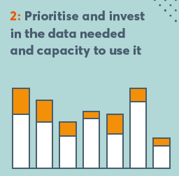
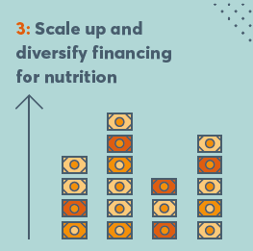
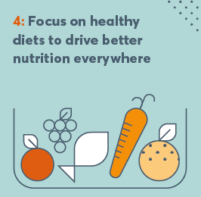
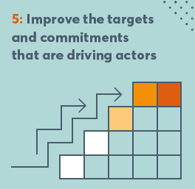

Slide 37
Development Initiatives Ltd North Quay House Quay side Temple Back Bristol BS1 6FL
globalnutritionreport.org

