Slide 1


Slide 2
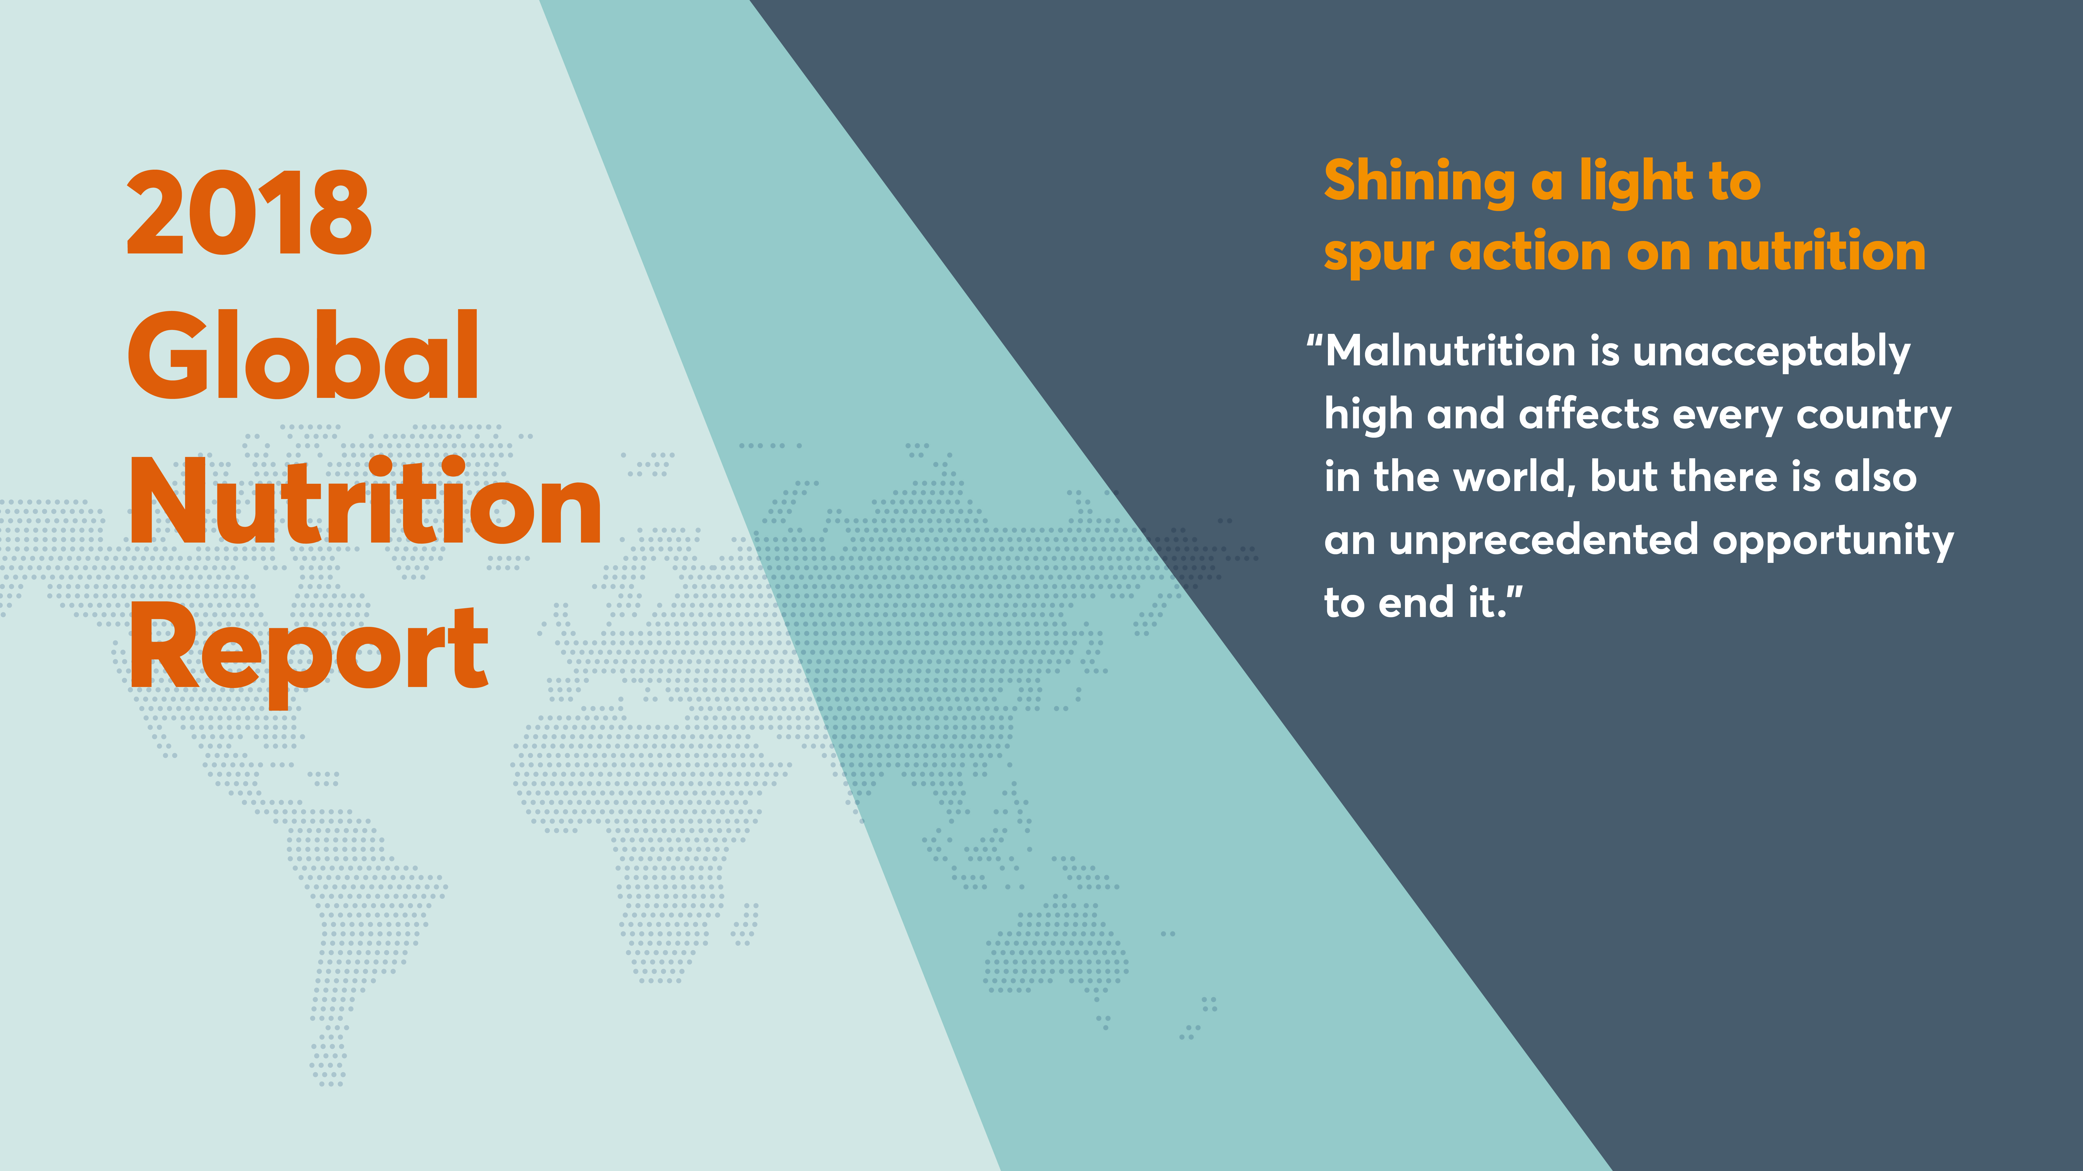
Professor Corinna Hawkes
Director, Centre for Food Policy, City, University of London
Co-Chair, Independent Expert Group of the Global Nutrition Report
2018 Global Nutrition Report
November 2018

Slide 3
About the GNR

Slide 4
The Global Nutrition Report 2014 to today
2018 Global Nutrition Report
Shining a light to spur action on nutrition
2017 Global Nutrition Report
Nourishing the SDGs
2016 Global Nutrition Report
From promise to impact: ending malnutrition by 2030
2015 Global Nutrition Report
Actions and accountability to advance nutrition and sustainable development
2014 Global Nutrition Report
Actions and accountability to accelerate the world’s progress on nutrition

Slide 5
The 2018 Global Nutrition Report
Chapter 1
Why malnutrition matters
Chapter 2
The burden of malnutrition
Chapter 3
Three issues in critical need of attention
Chapter 4
What people eat and why it matters
Chapter 5
The fight against malnutrition – commitments and financing
Chapter 6
Critical steps to get nutrition on track

Slide 6
Malnutrition is a universal problem

Slide 7

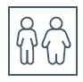
The global burden of malnutrition is
unacceptably high
Children under 5
1 in 5 stunted
15.9m stunted and wasted
8.23m stunted and overweight
34% of children in conflict states are
affected by stunting, compared with 20%
in non-conflict states
Adults
1 in 3 either overweight or obese
Adolescents
Record overweight
and obesity
Undernutrition explains around
45% of deaths among children
under five, mainly in low and
middle-income countries

Slide 8
Stunting is declining (2000–2017)
Most significant declines are in Asia and Latin America and the Caribbean
198.4
150.8
Children affected, millions
30.1
38.3
Stunting
Overweight
Source: NCD Risk Factor Collaboration

Slide 9










48% of countries are on track for at least one nutrition target
Global nutrition targets for 2025
Global non-communicable disease targets for 2025 (diet-related)
TARGET 1:
40% reduction in the number of children under 5 who are stunted
TARGET 4:
No increase in childhood overweight
TARGET 4:
30% relative reduction in mean population intake of salt
TARGET 2:
50% reduction of anaemia in women of reproductive age
TARGET 5:
Increase the rate of exclusive breastfeeding in the first 6 months to at least 50%
TARGET 6:
A 25% relative reduction in the prevalence of raised blood pressure
TARGET 3:
30% reduction
in low birth weight
TARGET 6:
Reduce and maintain childhood wasting to less than 5%
TARGET 7:
Halt the rise
in obesity and diabetes

Slide 10
Yet progress towards targets is too slow
Maternal, infant and young child nutrition targets
Nutrition-related NCD targets
Anaemia
Obesity, men
49
138
7
180
14
Exclusive breastfeeding
Obesity, women
31
13
20
130
178
16
Childhood stunting
Diabetes, men
24
27
16
127
8
182
4
Childhood overweight
Diabetes, women
38
23
133
26
164
4
Childhood wasting
On course
Some progress
37
12
24
121
No progress or worsening
No data

Slide 11
Rates of anaemia and women underweight have barely changed, while obesity is rising
Global prevalence of anaemia, overweight (including obesity) and underweight in women, 2000–2016
Prevalence of overweight and obesity among adult women (18+)
39.2%
31.7%
Prevalence of anaemia among women of reproductive age (15–49)
31.6%
32.8%
Prevalence of underweight among women aged 20–49
Prevalence, %
11.6%
9.7%

Slide 12


88% of countries face overlapping burdens
Number of countries with overlapping forms of childhood stunting, anaemia and overweight in adult women, 2017 and 2018
Anaemia only:
5 countries
Anaemia and stunting: 26 countries
Stunting only:
1 country
15.95m children stunted and wasted
Overweight
and stunting:
3 countries
Overweight, anaemia and stunting: 41 countries
8.23m children stunted and overweight
Overweight and anaemia: 54 countries
141 countries
in total
Overweight only: 11 countries

Slide 13

Spotlight on the UK
10.1% (8.4 million people) live in households where adults report insecure access to food
More than 1 million emergency food parcels given out by the Trussell Trust in 2016/17
22% of girls aged 11-18 % below the Lower Reference Nutrient Intake value for calcium; 27% for zinc; 54% for iron
1.3 million people over age 65 experience, or are at risk of, undernutrition
Obesity in the UK

Slide 14
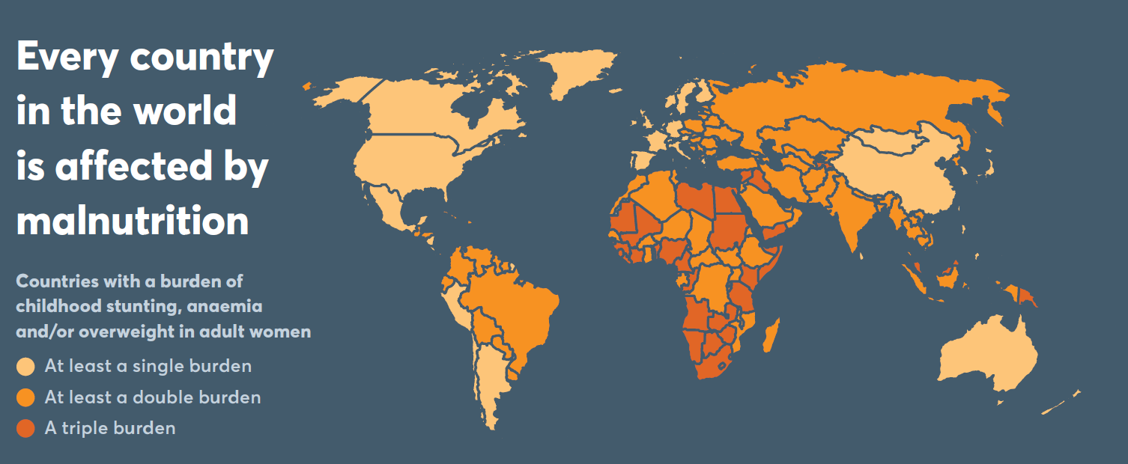

Every country in the world is affected
by malnutrition
Every country has
a malnutrition problem, irrespective of wealth
88% of countries experience more than one type of malnutrition burden
2018 Global Nutrition Report

Slide 15
The poor quality of diets among infants, young children, adolescents and adults is universal - and unacceptable

Slide 16
Diets low in nutritious foods are a leading cause of healthy life years lost
Risk factors
DALYs related to each dietary risk factor
A diet that is low in
A diet that is high in
70
62.6
61.0
Ischemic heart disease
60
50
49.5
47.6
Other cancers
40
35.5
Diabetes mellitus
33.3
DALYs, millions
30
Ischemic stroke
20.1
20
14.2
Intracerebral hemorrhage
8.4
10
5.1
Colon and rectum cancer
3.4
3.2
2.6
1.2
0.8
0
Other
Salt
Trans
fatty acids
Processed
meat
Real
meat
Sugar-
sweetened
beverages
Whole
grains
Fruits
Nuts and
seeds
Vegetables
Seafood
omega-3
fatty acids
Fibre
Legumes
Poly-
unsaturated
fatty acids
Calcium
Milk

Slide 17
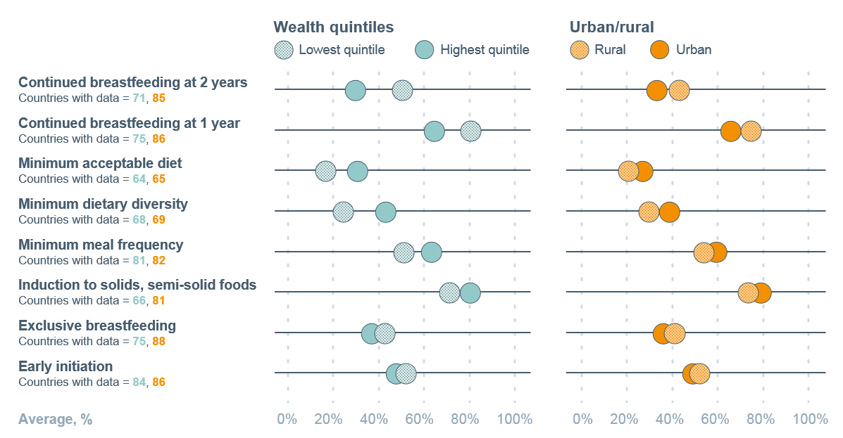
Diets of infants and young children are suboptimal everywhere in all wealth groups
74.6% of children 6–23 months of age do not have sufficient diet diversity for a healthy diet –
75.6% in lowest wealth quintile
56.7% in highest wealth quintile

Slide 18
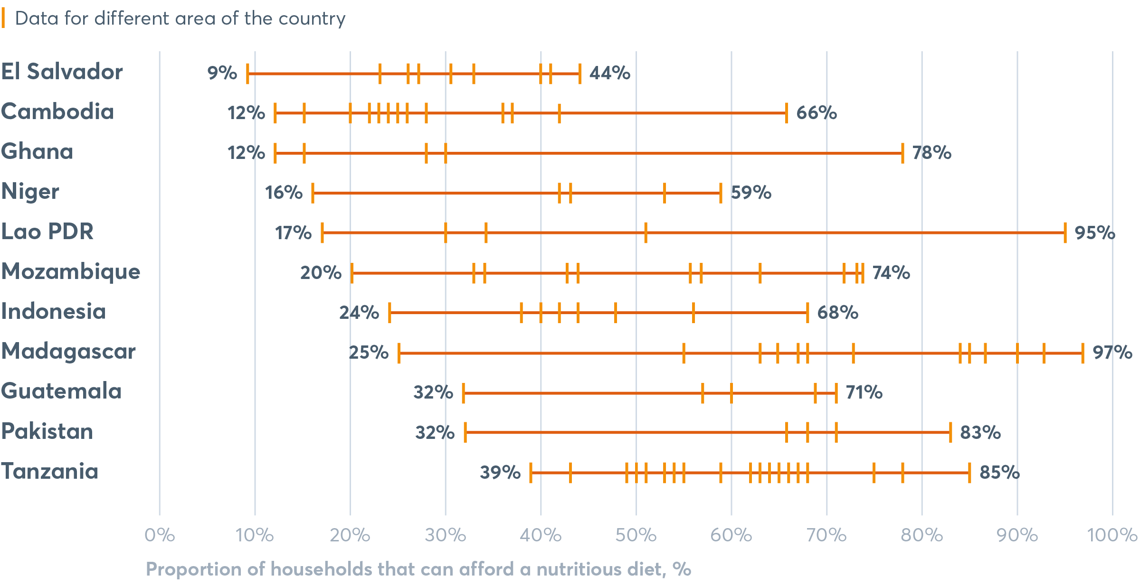
Many countries have areas where majority of people cannot afford a nutritious diet
Results from the World Food Program Fill the Nutrient Gap Tool

Slide 19
The cost of nutritious diets in the UK
According to The Food Foundation study Affordability of the UK’s Eatwell Guide (September 2018), the cost of the UK Government’s recommended diet is 74% of the household income of the poorest families (£41.93 per adult per week, or £103.17 per week for a family of two adults and two children)
Source: Food Foundation, 2018

Slide 20

Exclusive breastfeeding has increased 4 percentage points since 2012 to 41%
Burkina Faso
Exclusive breastfeeding rates improved from 9% to over 50% between 1992 and 2014
TARGET 5:
Increase the rate of exclusive breastfeeding in the first 6 months to at least 50%
Nepal
Exclusive breastfeeding in targeted districts increased from 46% to 70% between 2012 and 2016

Slide 21
Infant formula (0–36 months) sales increased from 16.0kg–28.5kg per infant 2005–2017
Trends and patterns in per infant/child commercial breast milk substitutes sales by region, 2005–2017
60
56.2
55.2
51.5
49.0
50.3
50
47.3
43.7
40
40.6
Standard
(0–6 months)
29.2
28.5
30
Sales (kg) per infant/child
25.7
24.6
21.6
Follow-up
(7–12 months)
20.7
20.3
20
17.2
15.7
16.0
Growing-up
(13–36 months)
11.7
12.3
10
5.9
6.5
7.1
Special
(0–6 months)
5.0
0
2005
2009
2013
2017
2005
2009
2013
2017
2005
2009
2013
2017
2005
2009
2013
2017
2005
2009
2013
2017
2005
2009
2013
2017
North America
Europe
Asia
Latin America
Africa
Global

Slide 22
In some regions up to 33% of school-aged children eat no fruit daily – and up to 59% consume soda
Prevalence of daily fruit, vegetable and soda intake among school-age children and adolescents
Asia
Oceania
Africa
Latin America
and the Caribbean

Slide 23
69% packaged foods aren’t aligned with healthy diets
Trends and patterns in per capita packaged food category sales by region, 2005–2017
Breakfast cereals
180
175
168
Ready meals
166
164
Sweet biscuits, snack
bars and fruit snacks
160
144
147
146
145
142
145
140
133
138
Confectionary
125
121
120
120
116
Savoury snacks
100
KG per capita
Ice cream and
frozen desserts
80
77
65
71
68
71
74
Edible oils
60
54
61
46
51
Sauces, dressings and
condiments
40
35
40
Processed meat and seafood
20
Dried processed foods
0
2005
2009
2013
2017
2005
2009
2013
2017
2005
2009
2013
2017
2005
2009
2013
2017
2005
2009
2013
2017
2005
2009
2013
2017
2005
2009
2013
2017
Baked goods
North America
Europe
Oceania
Asia
Latin America
Africa
Global

Slide 24
Percentage of unhealthy packaged foods higher in “emerging” markets
Note: Amended from Global Nutrition Report 2018

Slide 25



What we are eating (or not) in the UK
69% of packaged foods in the UK do not align with healthy diets
8% of UK teenagers meet the 5 A Day recommendation for fruit and vegetables
Children aged 1.5-3 years consume 11.3% of their calories from added sugars, more than double recommendations.
England, 2018
Adults 19-64 years eat on average 19g dietary fibre per day, far less than the recommended 30g
Meat intake in women meets the recommendation of no more than 70 g/day but men exceed recommendations
All age groups have a mean consumption of oily fish well below the recommended one portion (140g) per week.
Source: Public Health England, 2018

Slide 26
The opportunity has never been greater to effect change

Slide 27
More and better data is being collected, collated and analysed
Global Dietary Database
Collating, processing and disseminating data on dietary intakes of major foods and nutrients for adults by age, sex, maternal status, education and rural or urban location.
Includes estimates for 187 countries.
The International Network for Food and Obesity/NCDs Research, Monitoring and Action Support (INFORMAS)
Monitors and benchmarks efforts to create healthy food environments and rates public and private sector policies and actions to reduce obesity and NCDs.
FAO/WHO Global Individual Food Consumption Data Tool (GIFT)
Collates existing subnational and national datasets to provide an open-access platform to make individual quantitative food consumption data from all countries around the world.
CO-CREATE
Consortium of researchers from Europe and South Africa identifying solutions for obesity in adolescence through a systems approach and involving young people in all aspects of the project.

Slide 28




There is progress in effective policies and programmes
More countries have mandatory fortification
86 countries now require at least one type of cereal grain to be fortified with iron and/or folic acid. Only 19 countries are still classified with insufficient iodine intake, a dramatic shift from 110 countries in 1993
3. Multi-sector action
in cities is growing
Decline of obesity in Amsterdam by 12.5%, small but declines in municipalities in the US
2. Governments are acting
to improve diets
59 countries impose taxes on sugar-sweetened beverages, many in the context of excess intake: Mexico saw 9.7% decline in spending on sugary drinks within 2 years
4. Multi-level, community based interventions show rapid impact
Minimum dietary diversity prevalence increased 5.2%–24.9% in communities with intense activity by “Alive and Thrive” in Ethiopia 2015–2017

Slide 29
The uncomfortable question is not so much why things are so bad, but why things are not better given how much more we know than before?

Slide 30


